Slide 1
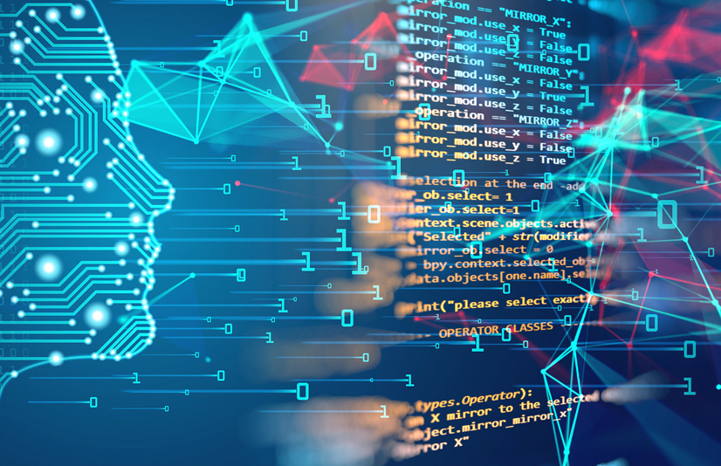
Final Project Proposal For Machine Learning
Ang wee hwa 13/4/2021
DS105

Slide 2

Problem Statement
Ang wee hwa 13/4/2021
To predict the future price increase or decrease percentage of bitcoins

Slide 3

Sub - questions
Ang wee hwa 13/4/2021
1) What is the correlation ships between the coins?
2) When to buy bitcoin?

Slide 4
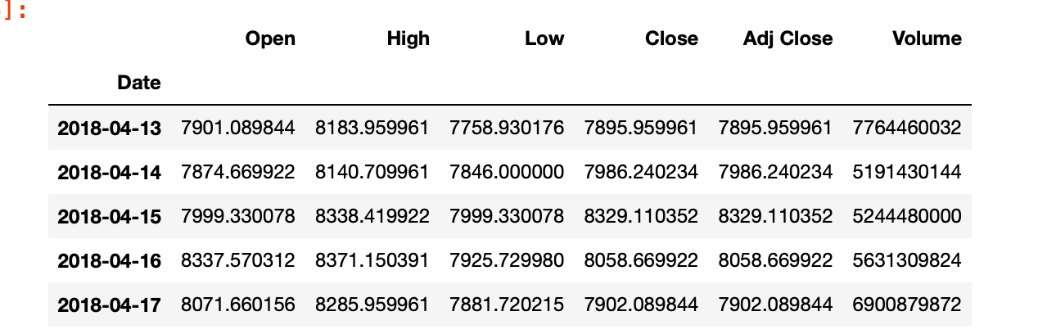
Dataset
Ang wee hwa 13/4/2021
A library in python yfinance by yahoo finance which is able to pull data or price from yahoo finance as a data frame in photon
The data pulled will include columns :open 1) price per day
2) highest price of the day
3) Lowest price of the day
4) Closing price of the day
5) Adj closing
6) Volume of the day

Slide 5
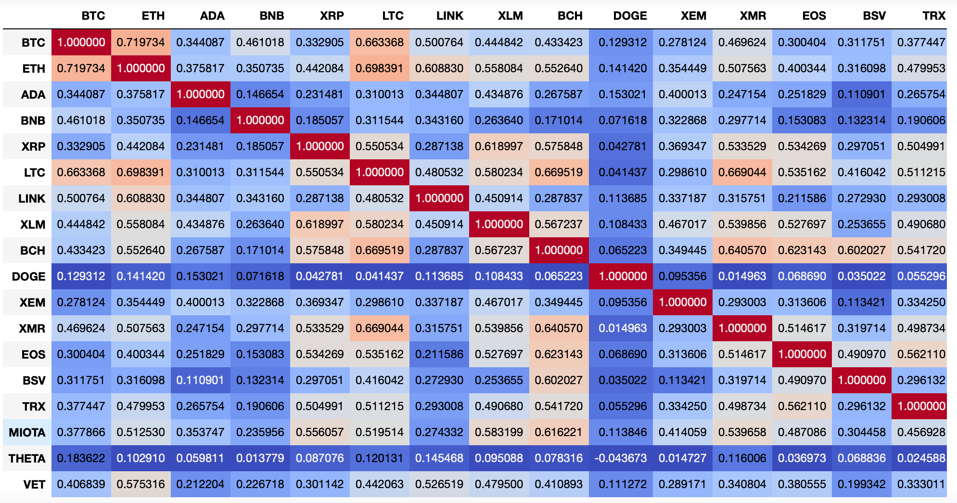
Data cleaning
Ang wee hwa 13/4/2021
We will be extracting 18 coins prices hence will unify the columns by creating a new column (diff) by taking the closing price deduct by opening price divide by the opening price multiply by 100 to have the percentage gain or loss on the day.
Next we will merge all dataset together
With the new dataset we will check for null value and drop if necessary.
After which we will do a correlationship check using the heatmap.

Slide 6
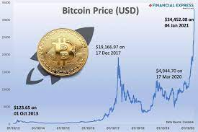
Difficulties
Ang wee hwa 13/4/2021
Data is live hence figures is ever-changing hence model may not be able to capture certain trends.
Price is affected by many other factors including news, partnerships or profit taking over certain period which cause spike and dip in prices hence machine might not be able include them as features to consider when doing the learning.

Slide 7
Machine Learning Model
Ang wee hwa 13/4/2021
For this problem statement I will be using supervise learning regression models as we are predicting the future price changes percentage. Will use standard scaler to scale the datas.
Linear Regression
SVR
Random Forest
XGBoost
After comparing the performance of the 4 models will select the one with the best prediction to do hyper parameter tuning.

Slide 8
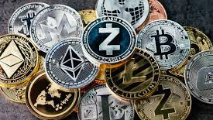
“Blockchain is the tech. Bitcoin is merely the first mainstream manifestation of its potential.”
Marc Kenigsberg

